Slide 1
Holly Erickson
DSC 530 Term Project

Slide 2
Statistical Question / Hypothesis
Left-handed batters perform better against right-handed pitchers than right-handed batters do, and this difference is statistically significant.

Slide 3
5 Variables & What They Mean
Exit Velocity for left-handed batters = The speed at which the ball is hit by the batter
Exit Velocity for right-handed batters = For both Exit Velocities in this analysis I will only consider the performance against right-handed pitcher
Hit Result for left and for right-handed batters = 1st, 2nd, 3rd or Home Run was reached
Angle = Launch angle of the ball

Slide 4
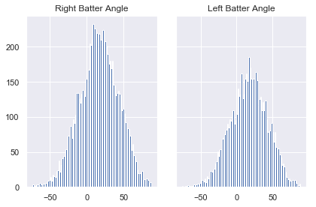
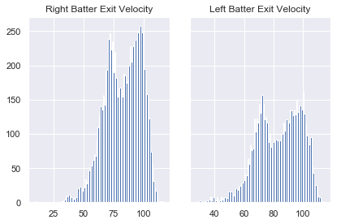
Right Batter Angle
- Mean: 16.5
- Mode: 11
- Spread: 693.241
Left Batter Distance
- Mean: 17.3
- Mode: 19
- Spread: 658.05
Right Batter EV
- Mean: 82.5
- Mode: 98
- Spread: 225.17
Left Batter EV
- Mean: 83.4
- Mode: 72
- Spread: 221.85

Slide 5
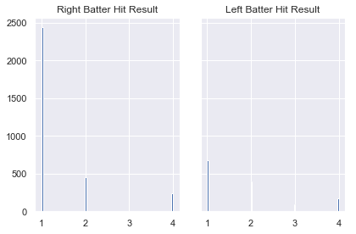
Right Batter Hit Result
- Mean: 1.4
- Spread: .69
Left Batter Hit Result
- Mean: 1.8
- Spread: 1.04

Slide 6
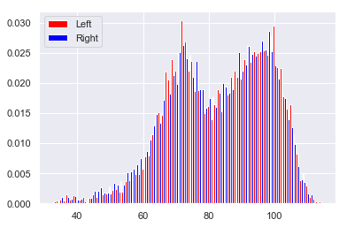
Exit Velocity PMF

Slide 7
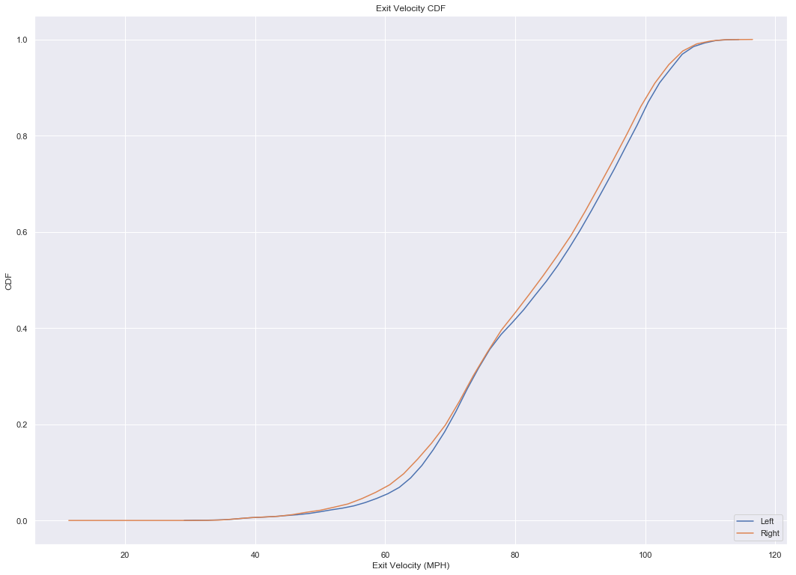

Slide 8
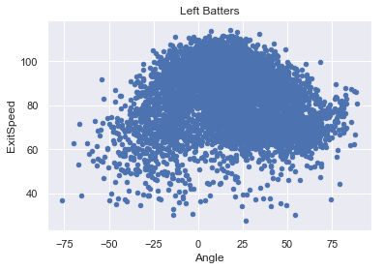
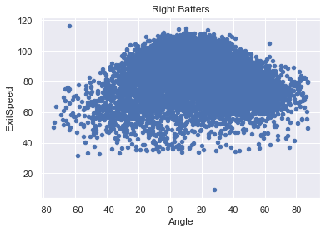

Slide 9
Pearson Correlation Matrix
ExitSpeed Distance HangTime Angle Batter Side Result
ExitSpeed 1.000000 0.350438 0.125902 -0.059459 0.015856 -0.047630
Distance 0.350438 1.000000 0.871052 0.699146 0.019311 -0.073087
HangTime 0.125902 0.871052 1.000000 0.877223 0.021427 -0.054192
Angle -0.059459 0.699146 0.877223 1.000000 0.019717 -0.056600
Side 0.015856 0.019311 0.021427 0.019717 1.000000 -0.086099
Result -0.047630 -0.073087 -0.054192 -0.056600 -0.086099 1.000000
Batter handedness (side) is not correlated with the outcome of the play. (-.09 is very weak)

Slide 10
Calculating the P-Value for Exit Speed Difference
Right Batter EV
- Mean: 82.5
- Std: 15.005852579832139
- Count: 8786
Left Batter EV
- Mean: 83.4
- Std: 14.894659945008556
- Count: 6130
P-value = 0.0005778546946593656
This is significant, meaning we can reject the null hypothesis.

Slide 11
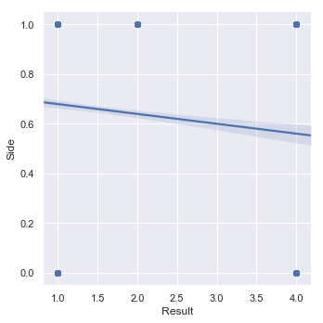
Linear Regression. I think this was not a good example to do because side is always either left or right.

